Slide 1
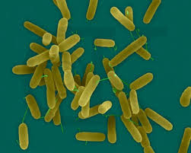
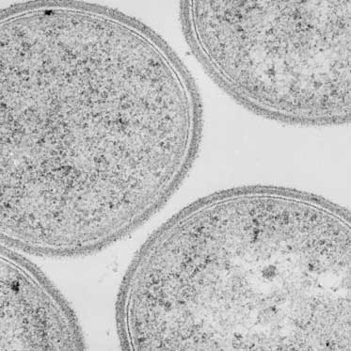

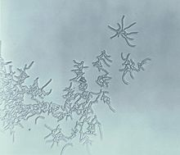
PSEUDOMONAS
HEY, I’M PLASTIC!
BREVIBACILLUS
RHODOCOCCUS
POLYDEMENTOR!!!

Slide 2
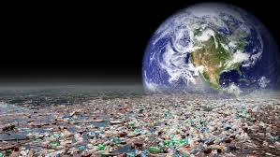
WHAT IS LDPE?
Low Density Polyethylene is a polymer made of long chain
monomers of ethylene.
It is a thermoplastic commodity mostly used for packaging.
The worldwide utility of polyethylene is
expanding at a rate of 12% per annum
and approximately 140 million tonnes of
synthetic polymers are produced each year.
With such huge amounts of
polyethylene getting accumulated in the
environment, their disposal evokes a big ecological issue.
It takes thousand years for degradation. The durability, light weight of it causes end up in landfills and natural water resources.

Slide 3
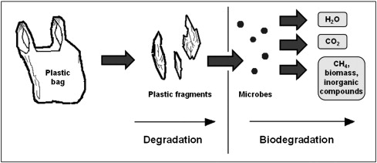
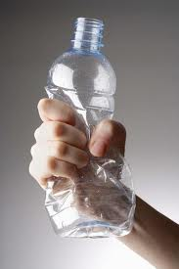
Disposal methods
Recycling is not economically due to the cost factor and loss of mechanical properties.
So, biodegradation serves an alternative.

Slide 4
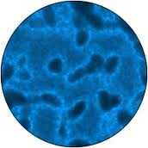
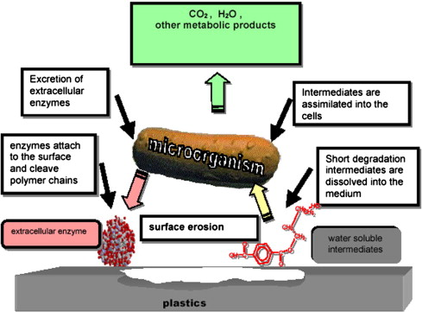
Microbial degradation
Microbial degradation of plastics is caused by certain enzymatic activities that lead to a chain cleavage of the polymer .
These water soluble enzymatically cleaved products are further absorbed by the microbial cells where they are metabolized.
Aerobic metabolism results in carbon dioxide and water.

Slide 5
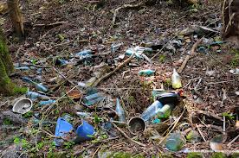
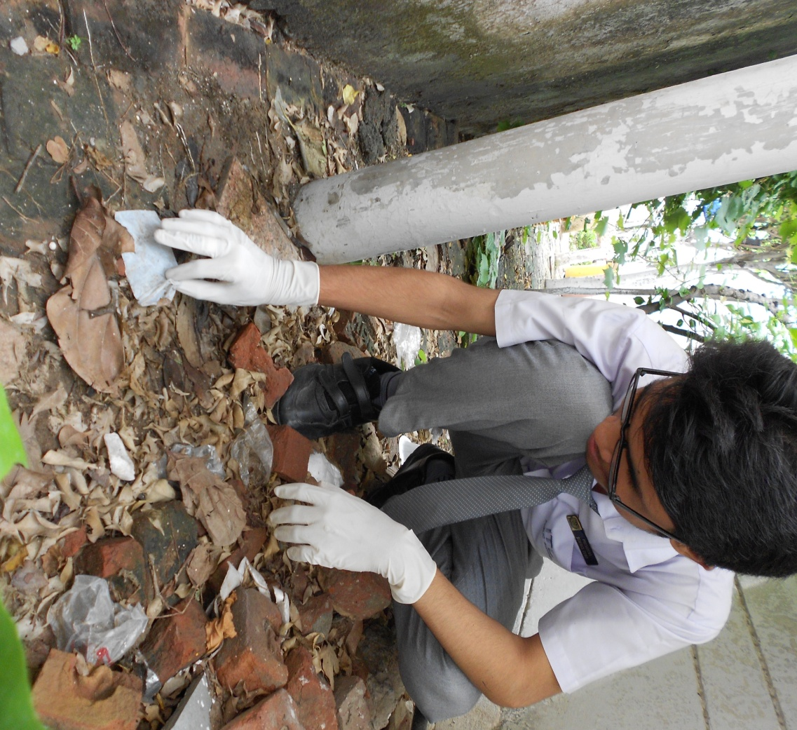
PROCESS of degradation
Collect some small pieces of low density polyethylene from a garbage dumping area.

Slide 6
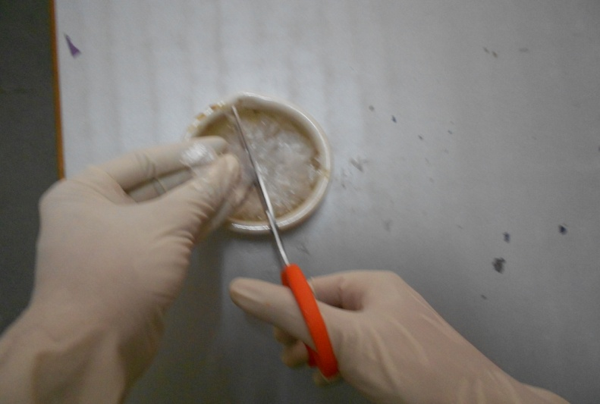
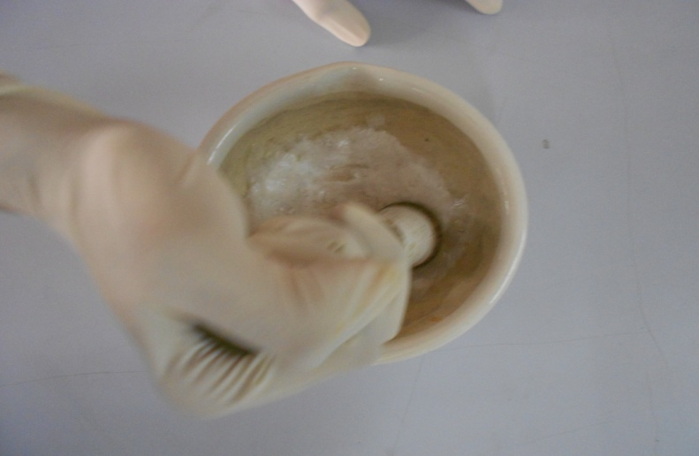
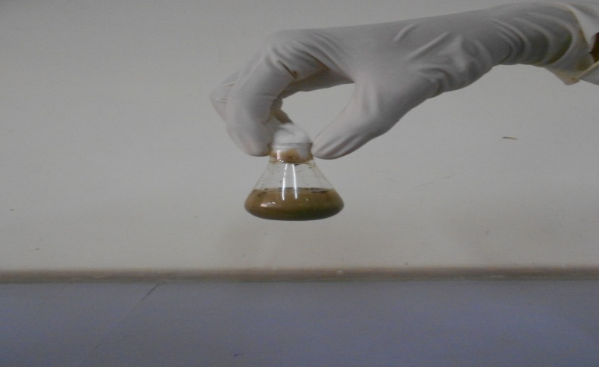
Pre-treatment of LDPE
The LDPE was cut in small and fine pieces, washed with ethanol ,distilled water, and air-dried.
The pieces were crushed in a mortar pestle with crystalline
NaCl to obtain fine ruptured
threads.
The mixture was transferred into a conical flask with distilled water and enzymes.

Slide 7
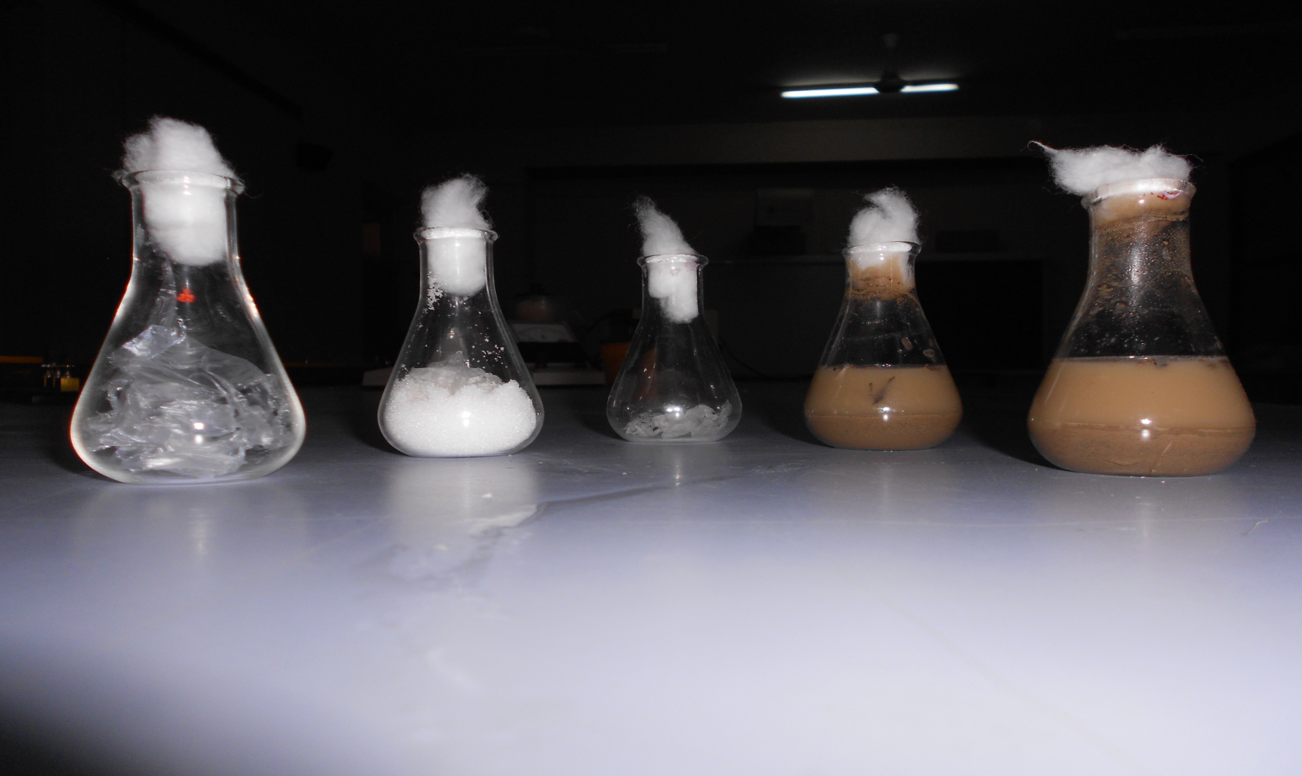
Treatment of LDPE
The isolated Pseudomonas spp. was inoculated in 100 ml of nutrient broth in respective conical flasks.

Slide 8
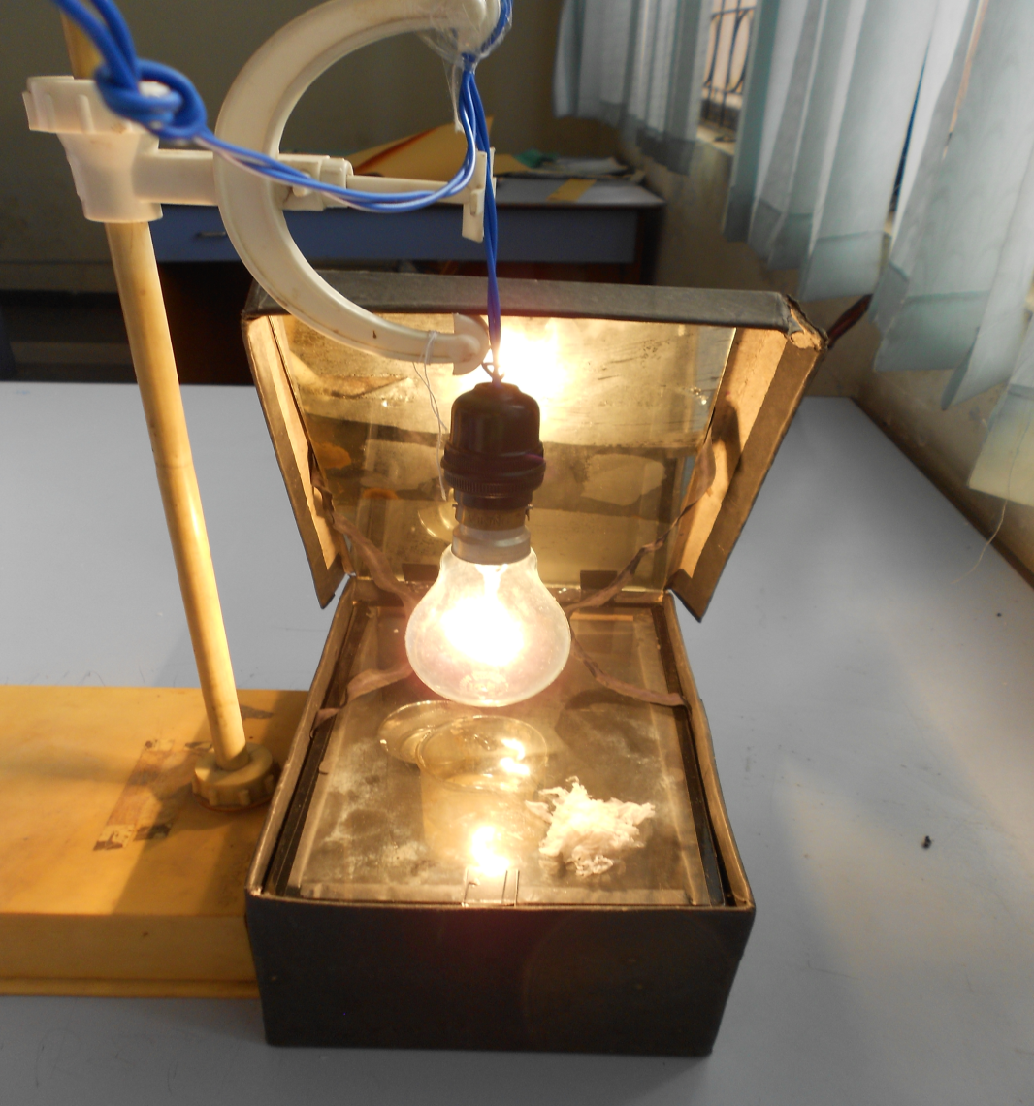
INCUBATION
It was incubated in an incubator shaker at 150 rpm for 3 weeks at 50-60⁰C.
Solar cooker and bulb was alternative method for this purpose.

Slide 9
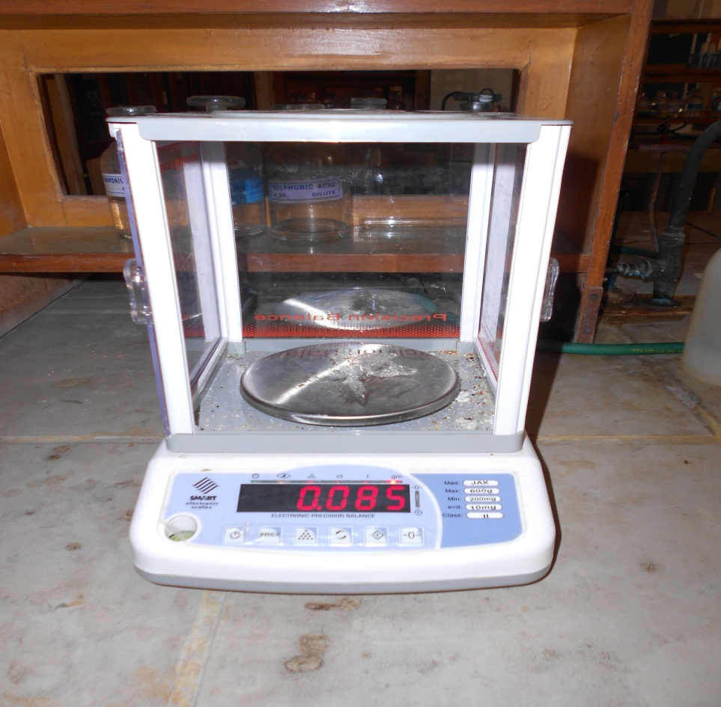
Dry Weight Determination of Recovered LDPE
The residual LDPE particles were recovered from the broth cultures by passing though a course filter paper.
The bacterial biofilm adhering to the polyethylene surface was washed by a 2% (v/v) aqueous sodium dodecyl sulphate solution for 2 to 3 hours and with distilled water.
The washed polyethylene particles were air-dried and weighed.

Slide 10
RESULT
After incubation, the culture flasks were removed from the incubator shaker and tested for the viability of microorganism .
The test results indicated a good stability of the bacteria in the medium with no sign of contamination.
Biofilm formation by the bacteria was clearly visible in the broth cultures and that of Pseudomonas was viscous and slimy.
Weight of PE*(g) Initial Final |  | Weight of PE degraded (g) | Percent of PE degradation
0 | 0 | 0 |  | 0
0.1 | 0.085 | 0.015 |  | 15

Slide 11
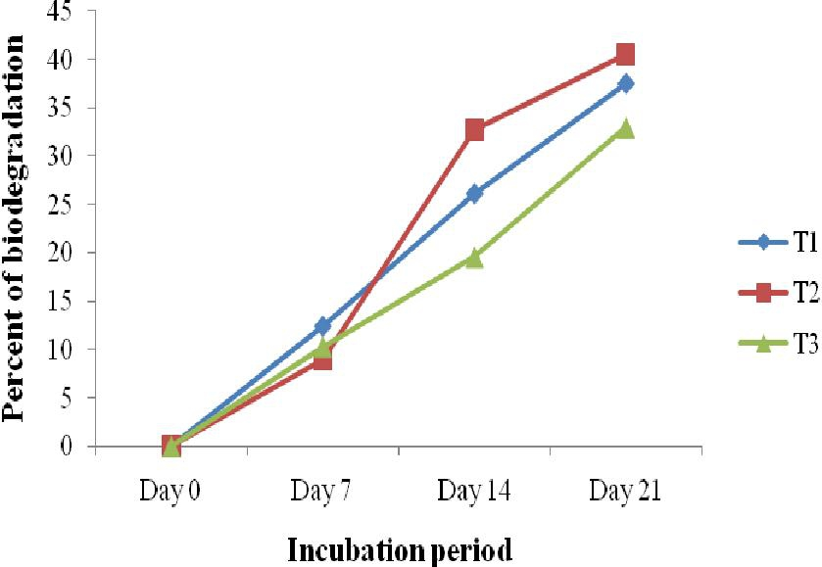
Incubation period
LDPE acted as the readily available source of carbon and energy.
The trend for T2 appeared slightly meander.
Initially in the first week Pseudomonas had a long lag phase in adapting to the changing environment
In the second and the third week a boost in the biodegradation rate was found which would have been possible for the enhanced biofilm help the bacteria to degrade formation and enzyme activities on LDPE particles.
The biofilm helped the bacteria to degrade the polymer and utilize it as the carbon source.
Trend of polyethylene biodegradation in different treatments

Slide 12
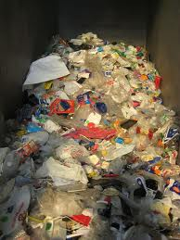
Factors of biodegradation
Biodegradation depends upon various factors such as:
Polymer characteristics
Organism type and
Nature of pre-treatment
The pre-treatment of LDPE is very significant for its biodegradation.
Physical rupturing of the polyethylene and chemical washing by ethanol might have added value to its degradability.

Slide 13

conclusion
The present research focuses on the biodegradation of LDPE by Brevibacillus, Pseudomonas, and Rhodococcus spp. by pure culture shake-flask incubation method. The percentage of biodegradation was evaluated by comparing the initial and final dry weights of polyethylene before and after incubation. The hypothesis of the study was microorganisms will utilize LDPE as the sole source of carbon and energy when the rest of the nutrients in the broth are limited.
Although there have been numerous investigations in degrading LDPE, yet the fate of these organic polymers in the environment and the time required for their complete mineralization to carbon dioxide needs to be fully understood . There is a growing interest in examining the activity of a consortium of microorganisms to expedite the biodegradation rate.

Slide 14
THANK YOU

